Slide 1
DIVISION OF
VOCATIONAL REHABILITATION
Project 10 Region 2
2011 Institute

Slide 2
When Does VR Get Involved?
Two years prior to exit
Students need to be able to participate in vocational activities and planning
When students are at risk of dropping out
Students beginning community based work experience
Visit www.rehabworks.org School to Work Transition Program for more information

Slide 3
What Documents Does VR Need?
Current IEP or 504 Plan
Medical and/or psychological records or new evaluations that document disability
Transcript or academic reports
Attendance and tardiness reports
Behavioral reports, if applicable
Vocational training records and/or career assessments, if available
Involvement with any other agencies

Slide 4
Order of Selection &
Financial Participation
VR remains under an Order of Selection
VR is serving Categories I and II
Most students will fall under I or II
Training is an exempt service for FP
Placement is an exempt service for FP
VR is required to explore comparable benefits
VR is a payor of last resort

Slide 5
Crisis Brings Issues into Focus
The Economy: Fewer jobs, more competition
Retired and Rehired: Elder citizens are returning to the workforce out of necessity
Three-A-Day: Individuals have to take multiple jobs to make a living
Lean Employers: Had to learn to do the job with fewer employees, trend will continue

Slide 6

What Does this Mean for Youth?
Can’t continue to pursue careers using the traditional employment model
Training & Education for Better Market Position
Create Support with a Network
Pursue Social Opportunities
Seek Out Work Experiences

Slide 7
Targeted Training for Employment
The Great Migration by Degree
Target training that is both in demand and provides employment options
What do employers look for…
Training needs to include hands-on time through internships, practicum or class design
Cross-class and count electives
Structure, Scheduling and Success
Notes:
Experience. Hourly rate vs salary and Benefits (insurance/leave).

Slide 8
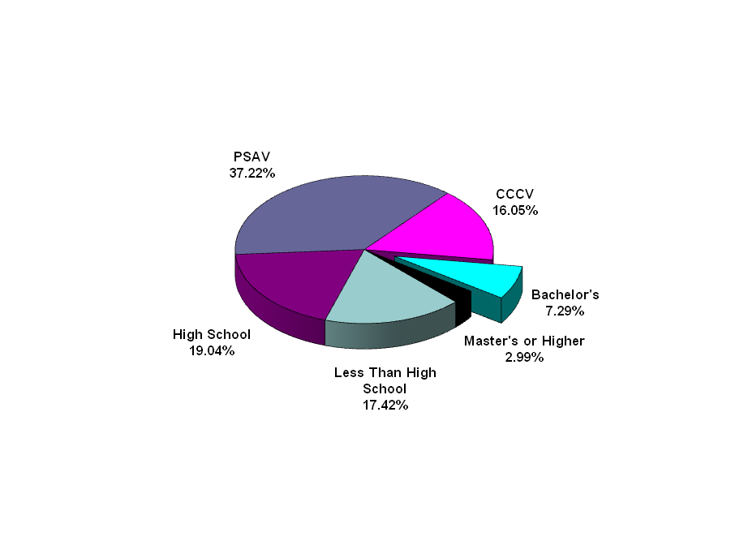
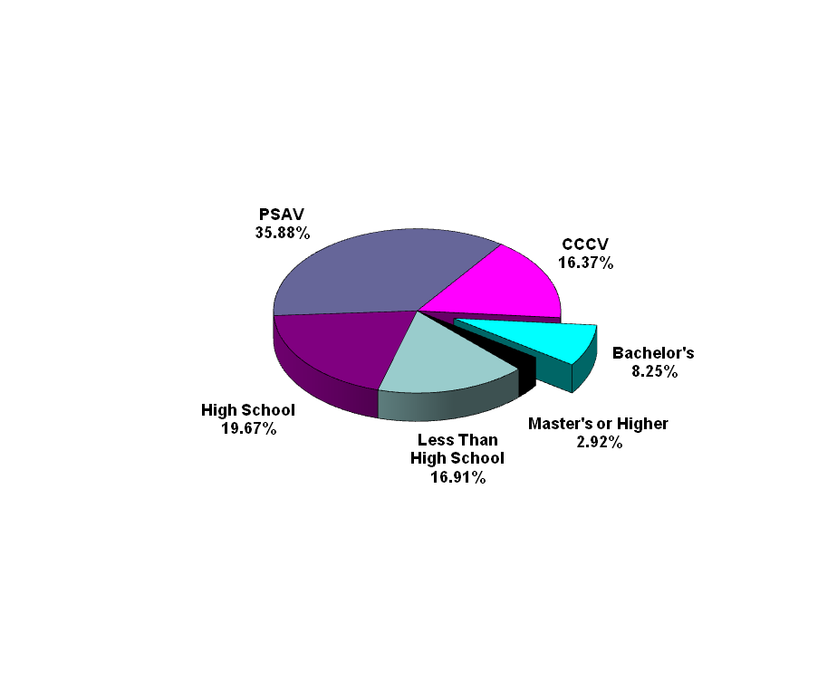
2009 Employment by Training Level
Florida’s employment breakdown by training level is very close to that of the U.S.
Florida
United States
PSAV = Postsecondary Adult Vocational Certificate
CCCV = Community College Credit/Vocational
Source: Florida Agency for Workforce Innovation, Labor Market Statistics, and U.S. Department of Labor, Bureau of Labor Statistics
Notes:
8

Slide 9
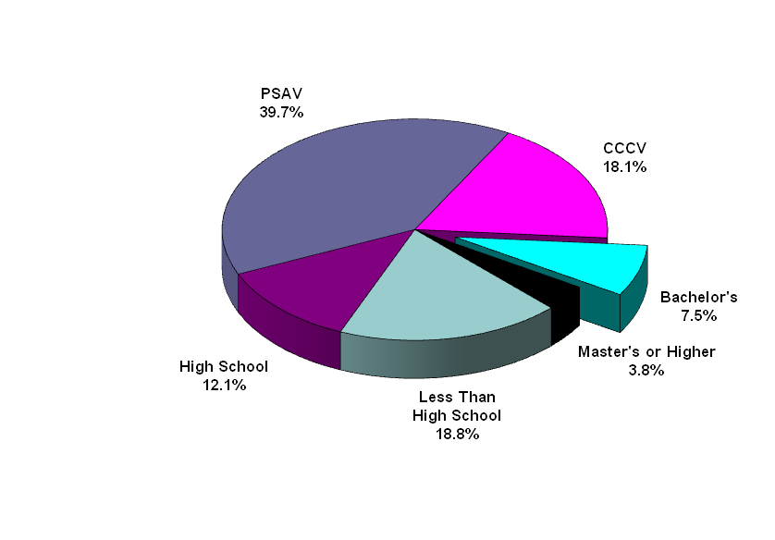
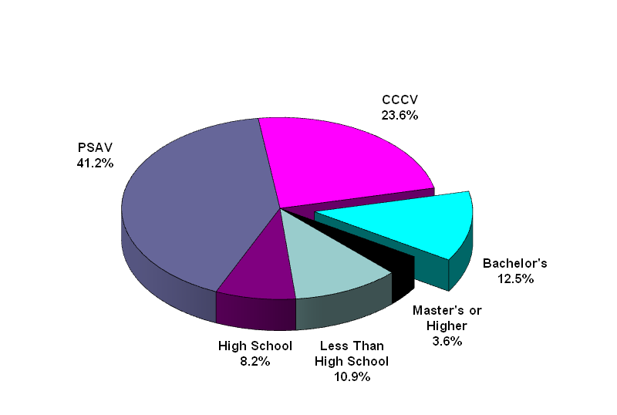
Percent Share of New Jobs by Training Level 2009-2017
The proportion of new jobs that require a bachelor’s degree will be higher in the U.S. than in Florida
Florida
United States
PSAV = Postsecondary Adult Vocational Certificate
CCCV = Community College Credit/Vocational
Source: Florida Agency for Workforce Innovation, Labor Market Statistics, and U.S. Department of Labor, Bureau of Labor Statistics
Notes:
9

Slide 10
Getting and Keeping A Job
WOM
Network Relationship

Slide 11


All the Time, Every Time
The Number “1” way people obtain employment…
Each activity that supports transition is an opportunity to network
Networks must be nurtured to build relationships that become supportive
Youth with disabilities enter the juvenile justice system 4x more often than non-disabled youth
Notes:
11
By engaging students with disabilities early we can help keep them in school & guide them into training, education and careers.

Slide 12

Relationship Building is a Struggle
Create a contact database or list early
~Person’s Name, Email, #
~What They Do or Like
~Where They Work
~Family, Friends, etc.
Regular contact to share/stay connected
Networking activities aid social development
Effective networking may require access to social media and technology

Slide 13

Social Butterflies
The loss of a first job is most often attributed to a lack of…
Youth often struggle in social settings or new situations
Studies indicate that suicide among youth can be avoided if they have one good…
Chronic behavioral issues require a closer look at root causes and the need for evaluation and treatment
Notes:
(environmental, physical and mental)
13

Slide 14
A Hard Day’s Night
The Number “1” best indicator of successful employment and independent living after high school?
On average, what number of jobs does it take before a person has a useful concept of work?
How many hours do you have to spend looking for a job each week to become employed?
Does an individual’s interests typically change while in high school?
Bring in working resources to engage students

Slide 15
School Activities Supporting Transition
Community Based Work Experiences
School Based Work Enterprises
Asset Development
High School/High Tech and Project Search
Social and Academic Interest Clubs and Organizations
Team/Individual Sports and their Supporters
Notes:
15
Explain basis for evidenced based and promising practices.
15

Slide 16
Activities Supporting Transition
Make Business Connections for Employer & Professional Mentoring
Volunteerism and Community Service
Centers for Independent Living
Career Centers
Recreation and Outdoor Activities/Centers
Faith-Based Activities
Youth and Social Clubs
Notes:
16
Explain basis for evidenced based and promising practices.
16

Slide 17
Leverage Technology “My Face-Space Place”
Social Media orientation for employment and networking is critical
Create a profile for online alerts and applications
Understand how online resumes and applications are screened by KSA’s
Use a Database or Social Media Scheduler to stay connected to your network
Learn assistive technology while in high school
Bring in “Techie” Stars to engage students

Slide 18
Give a Little, Get a Lot
Develop work and social skills
Build a resume
Employer and organization references
Potential employer exposure
Access untapped scholarships
Identify accommodations & assistive technology
Booster shot of self-esteem
Breaks the cycle of dependence

Slide 19
Know Your Agencies & When to Apply
Vocational Rehabilitation
Agency for Persons with Disabilities
Centers for Independent Living
Career and Service Centers
SSA Community Work Incentive Coordinators

Slide 20

The Key to Inclusion
Preference for Individuals with Disabilities
~Training Programs (Career & Technical)
~Work Experiences (Summer Work)
Signed Releases Between Professionals

Slide 21

Questions
Please Contact:
Kirk.Hall@vr.fldoe.org
(800) 451-4327 toll free
(850) 245-3360 direct line
Notes:
21

