Slide 1

Doing More with Less: Using Technology to Support Transition Services
16th International DCDT Conference
October 14, 2011

Slide 2
Presented by
Mary Podmostko, Assistant Director, Project 10
Patrick Mulvihill, Regional Transition Representative
University of South Florida St. Petersburg
529 1st Street South, SVB 108
St. Petersburg, FL 33701
p (727) 873-4661
f (727) 873-4660

Slide 3
Objectives
Describe/Demonstrate technology solutions for providing quality professional development and technical assistance in Florida
Assist in identifying solutions that may work in other states or districts

Slide 4
Project 10 Mission
To assist Florida school districts and relevant stakeholders in building capacity to provide secondary transition services to students with disabilities in order to improve their academic success and post-school outcomes.
Notes:
Project 10 is Florida’s statewide discretionary project supporting the secondary transition of youth with disabilities.
It serves as the primary conduit between the Florida Department of Education, specifically the Bureau of Exceptional Education and Student Services (BEESS), and relevant school district personnel in addressing law and policy, effective practices, and research-based interventions in the area of transition services for youth with disabilities.

Slide 5

Four Major Initiatives
Capacity Building
Interagency Collaboration
Transition Legislation & Policy
Student Development & Outcomes
Notes:
These initiatives help provide the training, technical assistance, and resources for personnel throughout the state who are working to improve the future success of students with disabilities.
The project also supports transition initiatives developed through BEESS and the BEESS Transition Steering Committee.
Project 10 uses regional personnel, 21st Century technology, extensive collaboration, and data-driven accountability to deliver services, supports, and information to all stakeholders focused on improving post-school outcomes for students served in exceptional student education within Florida.

Slide 6
Capacity Building
  Needs Assessment of Districts
    Strategic Targeting of Priority Needs
    Prioritizing Targeted Districts
    Training, Technical Assistance & Resources
    Preferred Method of Delivery
    Seek to Address Challenges
  District Mentoring Network
Notes:
Project 10 provides support for transition activities implemented through BEESS, specifically through the statewide development and implementation of evidence-based practices and alignment with general education initiatives.
Project 10 provides training and technical assistance, including product development and dissemination, to assist school districts and other stakeholders in building capacity to implement secondary transition.

Slide 7
Interagency Collaboration
Provide Support to State Secondary Transition Interagency Committee (SSTIC): input from stakeholders
Collaborate in Related State Activities
  Health Care Transition Task Force
  Traumatic Brain Injury/Spinal Cord Injury Transition Committee
  Florida Developmental Disabilities Council, Inc.
  Governor’s Commission on Disabilities
Support District Level Interagency Councils
Notes:
Project 10 provides funding and logistical support for developing and maintaining state and district level interagency activities.
Project 10 also identifies recommended practices in transition related interdisciplinary and interagency collaboration and partner in collaborative activities.

Slide 8
Interagency Partners
Florida Developmental Disabilities Council
Family Network on Disabilities (FND)
Florida Diagnostic and Learning Resources System (FDLRS)
Vocational Rehabilitation (VR)
Multiagency Network for Students with Emotional/Behavior Disorders (SEDNET)
Florida Inclusion Network (FIN)
Florida Consortium on Postsecondary Education and Intellectual Disabilities
Notes:
Project 10 collaborates with other agencies and discretionary projects in identifying and implementing methods for improving the transition outcomes of youth with disabilities, including those listed above.

Slide 9

Transition Legislation
& Policy
  Timely information when educators need it and can access it
  SPP/Transition Indicators guidance on website
  Florida SB 4 page on website
  “Transition Wheel”
Notes:
Project 10 provides training and technical assistance, including product development and dissemination, related to state and national legislation, State Board of Education Rule, and policy, including compliance requirements to transition stakeholders.
Unlike some other states, education policy in Florida is passed into law or is codified in the Florida Administrative Code (FAC). The governor appoints state Board of Education members to staggered terms of four years that are approved by the state Senate. The state BOE appoints the Commissioner of Education.

Slide 10
Student Development & Outcomes
Product Review, Revision & Updating
Pilot activities using best practices
Regional meetings
School-Based Enterprises
Programs for students 18 and older on age-appropriate campuses
Notes:
Project 10 provides training and technical assistance, including product development and dissemination, to transition stakeholders in assessment and instruction, student-centered planning and self-determination, independent living including recreation and leisure, postsecondary education and training, and career development and employment.
Project 10 supports exemplary transition sites that model the use of evidence-based practices of student development in improving transition outcomes.

Slide 11
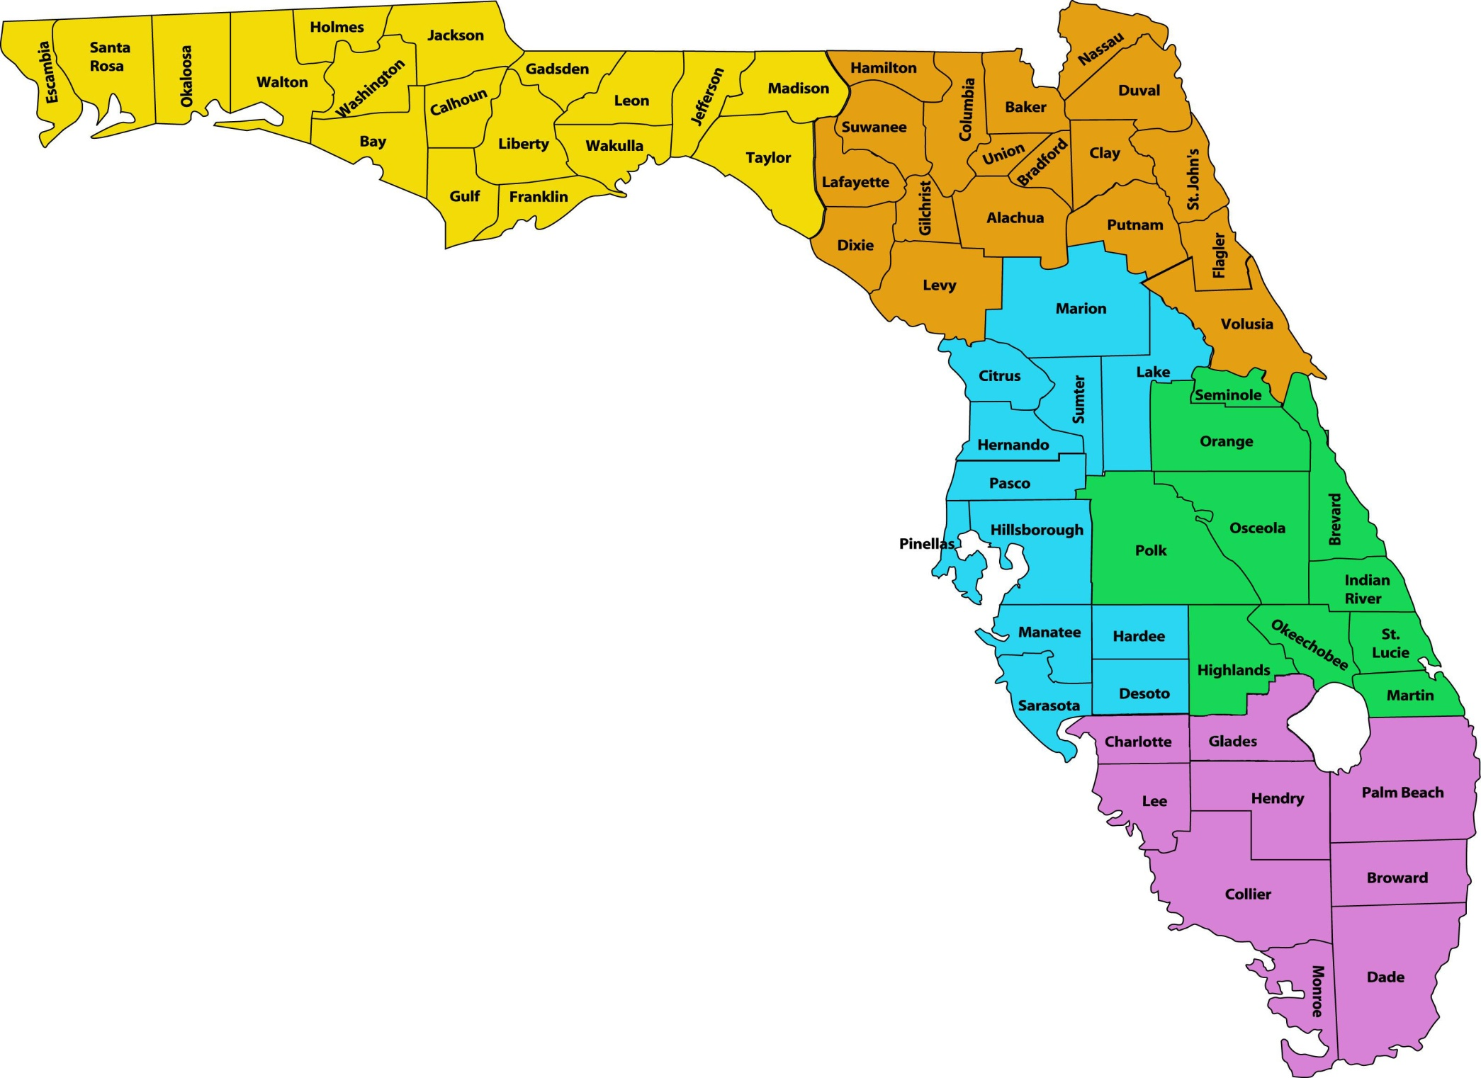
Regional Transition Representatives:
Yellow: Lori Garcia (1)
Orange: Patrick Mulvihill (2)
Green: Heather Mack (3)
Blue: Federico Valadez (4)
Pink: Lisa Friedman-Chavez (5)
Notes:
Project 10 has ten staff members including five Regional Transition Representatives who work directly with school district staff and relevant stakeholders in Florida’s 67 counties.

Slide 12
Regional Perspective
5 Regional Representatives
11 – 18 school districts per RTR
Initial needs assessment
Adobe Connect Sessions
  Secondary Transition Compliance
  Transition Assessment
  Summary of Performance
  Self-determination

Slide 13
Regional Perspective, continued
Meeting Wizard
Skype Staff Conferences
Teleconferences with multiple districts regarding indicators 1,2, 13, 14
Regional Conferences

Slide 14
Statewide Perspective
Project 10 Website
Publications
On-line Training Modules
Conference Presentations
Skype Teleconferences
Going Green
Notes:
After discussing these resources, technology options, and green programming options available in Florida, conference participants will view “live” on-line resources including the Project 10 website and on-line training modules.

Slide 15
Do you have
technology solutions
to share?
Notes:
If there is adequate time, participants will be asked if they have any technology solutions they would like to share.

Slide 16
Contact Information
Patrick Mulvihill
Region 2 Transition Representative
Northeast Florida
pmulvihill@mail.usf.edu
Mary Podmostko
Assistant Director, Project 10
maryp@mail.usf.edu

